Slide 1
L12 - Introduction to software processes
Study of software processes is the core of software engineering
  successful projects of the past
    the processes that worked well
    a prescription for the future projects
  unsuccessful projects
    find the problems that led to the failure
Good process → Good product
© 2012 Václav Rajlich Software Engineering: The Current Practice Ch. 12

Slide 2
Variability of processes
Team
  organization, collaboration, skills
System
  technology, domain, size, and expected quality
© 2012 Václav Rajlich Software Engineering: The Current Practice Ch. 12

Slide 3
Granularity
Coarse granularity processes
  deal with long periods of time
  software life span models are example of a process of very coarse granularity
  stages that are also processes
Word “process” usually used for processes that fit within a single stage or few neighboring stages
© 2012 Václav Rajlich Software Engineering: The Current Practice Ch. 12

Slide 4
Granularities of processes
Granularity | Example
lifecycle | staged, waterfall
stage | evolution, servicing
process | SIP, AIP
task | software change, acceptance testing
subtask, phase | concept location, actualization
step, action | inspection of a class
© 2012 Václav Rajlich Software Engineering: The Current Practice Ch. 12

Slide 5
Forms of process
Process model
  prescription what the tasks should be and how should they fit together
  a blueprint how to do things
Enactment
  the actual process in the project
  inevitable deviations and exceptions from the process model
© 2012 Václav Rajlich Software Engineering: The Current Practice Ch. 12

Slide 6
Forms of process (2)
Performance
  set of measures that an observer of an enacted process collects
    time, cost, quality, . . .
Plan
  expected future performance
  decisions that the project stakeholders take
    alternatives how to enact the process model
© 2012 Václav Rajlich Software Engineering: The Current Practice Ch. 12

Slide 7
Solo iterative process (SIP)
Single programmer repeats software changes
Functionality is added one step at a time
Repeated changes are the basis of
  software evolution
  software servicing, reengineering
SIP demonstrates characteristics shared by all iterative processes
© 2012 Václav Rajlich Software Engineering: The Current Practice Ch. 12

Slide 8
Why SIP at all?
Why should solo programmer follow a predefined process?
  rather than react flexibly to challenges
Answer: even the solo programmers have to meet their obligations
  fulfill their promises, pay their bills
  plan the future
  manage their own resources
SIP is the process that allows that
© 2012 Václav Rajlich Software Engineering: The Current Practice Ch. 12

Slide 9
Workproducts
Product backlog
  change requests
  represents the vision for the future of the software.
  bugs in the functioning of software
  new demands and ideas
Software code
Software documentation, etc.
© 2012 Václav Rajlich Software Engineering: The Current Practice Ch. 12

Slide 10
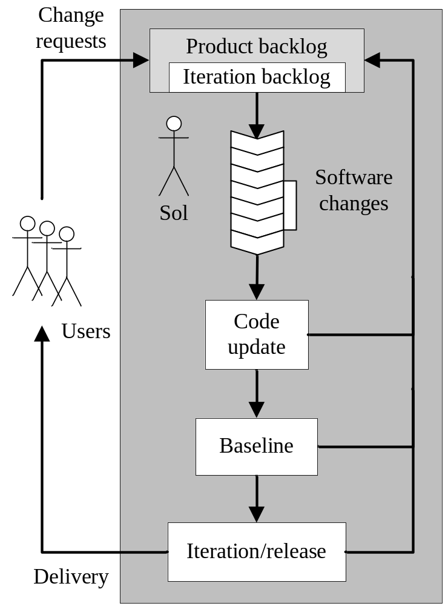
SIP model
© 2012 Václav Rajlich Software Engineering: The Current Practice Ch. 12

Slide 11
Enactment of SIP
Task |  | Comments
1 | Pri | New change request arrives
2 | Ini | Add Cashier Session
3 | CL | CashierRecord
4 | IA | Estimated set has 4 classes
5 | Ref | Extract class Session
6 | Ex | Install new version of Bugzilla
7 | Act | Replace class Session
8 | Base | 2 regression faults added to backlog
 |  | . . .
© 2012 Václav Rajlich Software Engineering: The Current Practice Ch. 12

Slide 12
Measuring SIP
Data indicate how the process is working
Data serve as a foundation for future planning
© 2012 Václav Rajlich Software Engineering: The Current Practice Ch. 12

Slide 13
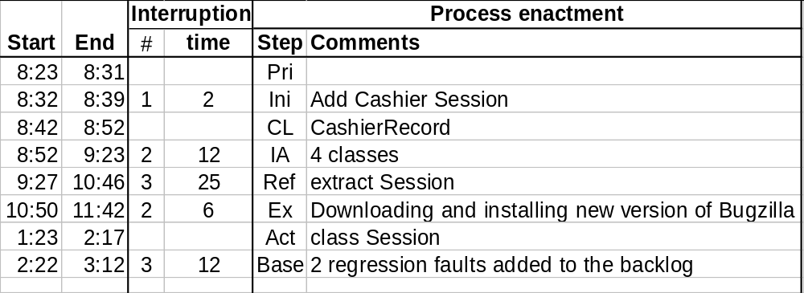
Time log
© 2012 Václav Rajlich Software Engineering: The Current Practice Ch. 12

Slide 14
Time
Total time
Clean time
  American football game
  15 minutes is the clean time of each quarter
  total time includes all interruptions
Clean time = end – start – time of interruptions
© 2012 Václav Rajlich Software Engineering: The Current Practice Ch. 12

Slide 15
Log = raw data
Can become large
From the log the following can be extracted
  weekly summary of the clean time
  average time for concept location
  concept location is becoming faster or slower
  recurring exception to the SIP
  . . .
© 2012 Václav Rajlich Software Engineering: The Current Practice Ch. 12

Slide 16
Program size
Number of lines of source code
  LOC, KLOC, MLOC
This measure is very inaccurate
  different programming languages=different size
  different programming styles=different size
© 2012 Václav Rajlich Software Engineering: The Current Practice Ch. 12

Slide 17
LOC
LOC is the most commonly used measure of program size
Only the one or two most significant digits are meaningful
  900 LOC, 23 KLOC, 3.2 MLOC
© 2012 Václav Rajlich Software Engineering: The Current Practice Ch. 12

Slide 18
Other measures
Function points
  correlate with LOC, harder to compute
Measures even less accurate than LOC
  number of methods in the source code
  number of classes
  number of files
© 2012 Václav Rajlich Software Engineering: The Current Practice Ch. 12

Slide 19
Code defects
Incorrect computations, premature termination
Defect density
  good quality software: ~2.0 defects per KLOC
  poor quality software: Higher density
  avionics software
    defect density estimated 0.1 defects per KLOC
    cutting edge of what can be achieved
    NASA Space Shuttle
© 2012 Václav Rajlich Software Engineering: The Current Practice Ch. 12

Slide 20
Defect log
Defect Found
Origin
Date
Time
Task
Location
Description
Date
Task
Fixed
for I = 0, loop does
1
11/4
9:00
CL
Cashier.get()
not terminate
3/12
Act
12/8
The pop
-
up window
for 3rd cashier does
2
11/4
2:32
Base
--
not ap
pear
?
11/25
Price = 0 raises
3
11/4
3:02
Base
Price.get()
exceptions
4/21
Ref
4
. . .
© 2012 Václav Rajlich Software Engineering: The Current Practice Ch. 12

Slide 21
Planning
Planning is a prediction of the future
  there are uncertainties and risks involved
Data about the past are good predictors about the future
  recording the past and planning the future are closely related
  future cannot be predicted with any level of certainty without knowing the past.
© 2012 Václav Rajlich Software Engineering: The Current Practice Ch. 12

Slide 22
Repetitions
Easiest things to predict are the repetitions
Eliminating the risk and uncertainty is one of the main topics of the planning.
  emphasize the repetitive nature of the process
  “repetition is the mother of skill”
Unique and unprecedented tasks are hard to plan
© 2012 Václav Rajlich Software Engineering: The Current Practice Ch. 12

Slide 23
Planning software changes
Analogy
  estimate the time needed for the phases
    find similar phases in the past, use their numbers as the basis
Decomposition
  decompose the change into phases
  get the sum for all phases
  errors may compensate each other
© 2012 Václav Rajlich Software Engineering: The Current Practice Ch. 12

Slide 24
Tasking
Changes should be made more alike
  they will be more predictable
Narrow range of size
  “epics”
  divide large changes into smaller ones
© 2012 Václav Rajlich Software Engineering: The Current Practice Ch. 12

Slide 25
Tasking example
“Customers can download and then use sales coupons online”
Subtasks
  build a web site for the store and coupons
  support the store manager to create and remove coupons
  customer payment involves cashing coupons
  database that stores how many coupons were used
© 2012 Václav Rajlich Software Engineering: The Current Practice Ch. 12

Slide 26
Baselines
Schedule them at regular intervals
  every day at the end of the shift
  every other day after a change is finished
Postponing is not recommended
© 2012 Václav Rajlich Software Engineering: The Current Practice Ch. 12

Slide 27
Release plan
Involve business considerations
Release with a certain new functionality on a certain date
  planning makes sure that this promise is realistic.
© 2012 Václav Rajlich Software Engineering: The Current Practice Ch. 12

Slide 28
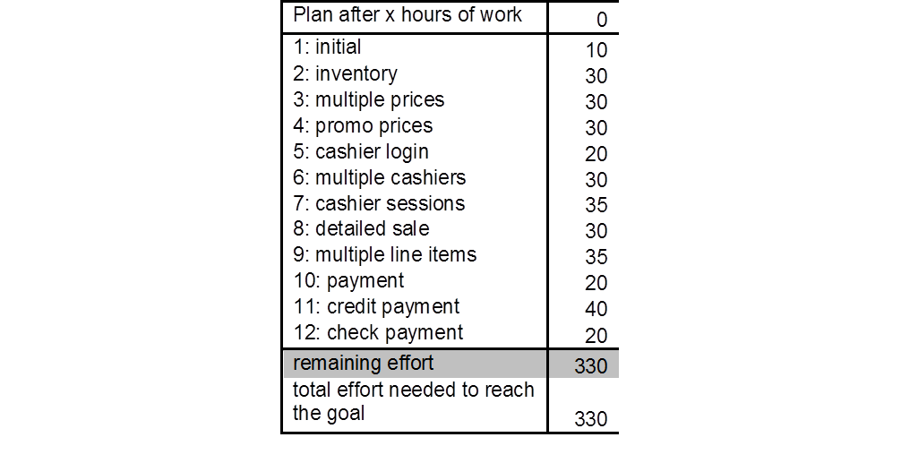
Release backlog table (original)
© 2012 Václav Rajlich Software Engineering: The Current Practice Ch. 12

Slide 29
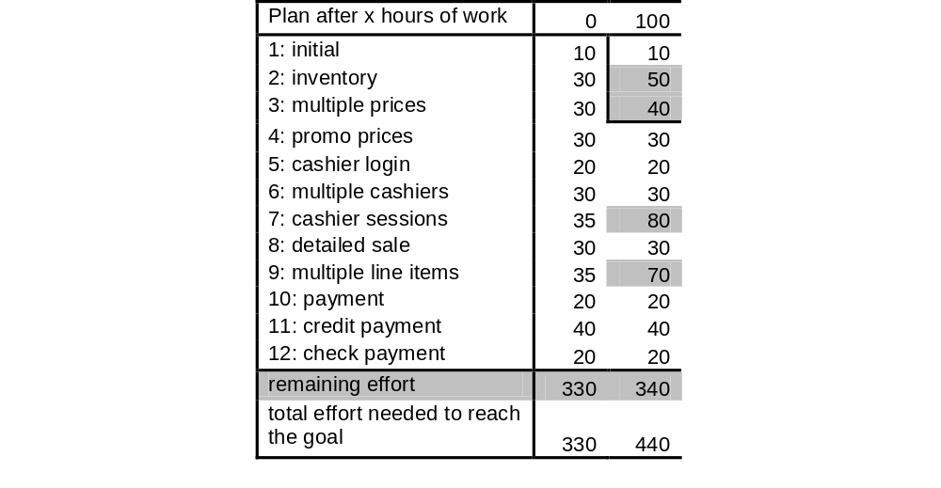
Release backlog table after 100 hours of work
© 2012 Václav Rajlich Software Engineering: The Current Practice Ch. 12

Slide 30
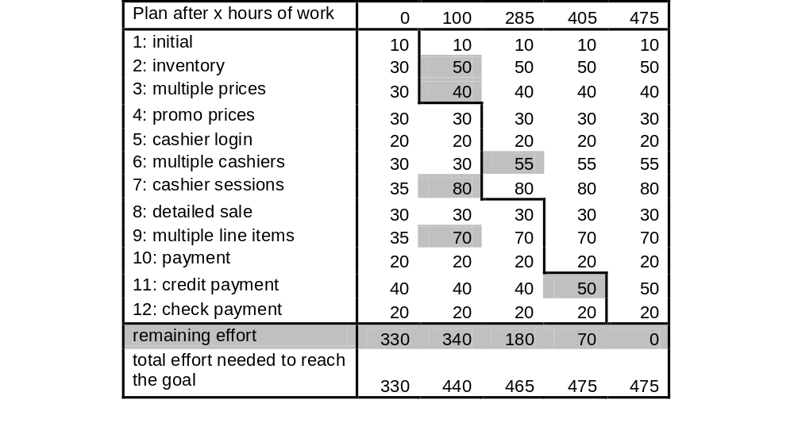
Release backlog table (late release)
© 2012 Václav Rajlich Software Engineering: The Current Practice Ch. 12

